Slide 1

Should I be Eating More Fish
LIVING WELL – Show 109
7/20/2024

Slide 2

Benefits of Eating Fish
Rich in Omega-3 Fatty Acids: Fish, especially fatty fish-like salmon, tuna, sardines, and mackerel, are rich in omega-3 fatty acids.
Omega-3s are essential for heart health, brain function, and may help reduce inflammation.
High-Quality Protein: Fish is a good source of lean protein, which is important for building and maintaining muscle mass.
Vitamins and Minerals: Fish provides essential vitamins and minerals like vitamin D, vitamin B12, selenium, iodine, and phosphorus.
Healthy Molecules: Polyphenols and Flavonoids
https://ods.od.nih.gov/factsheets/Omega3FattyAcids-HealthProfessional/#:~:text=Cold%2Dwater%20fatty%20fish%2C%20such%20as%20salmon%2C%20mackerel%2C,composition%20of%20the%20food%20that%20the%20fish

Slide 3
Considerations of Eating Fish
Mercury Levels: Some fish, particularly larger predatory fish like king mackerel, swordfish, and tilefish, can contain higher levels of mercury.
Pregnant women, women who may become pregnant, and young children are restricted due to mercury intake in fish. They can choose low-mercury fish options (Lower on the Food Chain).
Sustainability: Overfishing can deplete fish populations and harm marine ecosystems. Choosing fish caught using sustainable practices is important for the environment.
Personal Preferences: Do you enjoy the taste and texture of fish? If not, there might be other ways to get the nutrients fish offer, such as through supplements or other protein sources.
https://www.fda.gov/food/environmental-contaminants-food/fdaepa-2004-advice-what-you-need-know-about-mercury-fish-and-shellfish

Slide 4
Fish and Omega-3 as a Health Food
Eating fish 2-3 times a week is generally recommended as part of a healthy diet.
Choose a variety of low-mercury fish options caught using sustainable practices. (Lower on the Food Chain)
If you don't enjoy fish or have concerns about mercury intake, leafy vegetables or Flax seeds Foods. Flaxseed, canola oil, walnuts, sunflower seeds and soybeans are all good sources of omega-3 fatty acids.
Fortified foods. Yogurt, milk and eggs can be fortified with omega-3 fatty acids.
Supplements. Supplements typically contain fish oil or omega-3 fatty acids from marine plant sources with toxins removed. Many prenatal vitamins also contain DHA an Omega-3 for Brain Health.
Talk to your health care professional before taking any supplement.
https://www.fda.gov/food/consumers/advice-about-eating-fish

Slide 5

Omega-3 As a Dietary Supplement
According to a 2018 NCCIH survey, 7.8% of US adults and 1.1% of children ages 4–17 had taken a fish oil supplement in the previous 30 days.
A 2019 AARP article states that 10% of Americans take fish oil supplements to support their heart health.
A 2024 CNN article says that 20% of adults over 60 in the US frequently take fish oil supplements for the same reason
https://www.nccih.nih.gov/health/omega3-supplements-in-depth

Slide 6

Typical Americans Seafood Consumption
https://www.seafoodsource.com/news/foodservice-retail/americans-consumed-a-record-amount-of-seafood-in-2021
Popular Seafood Choices in the US:
In 2021, Americans ate a record 20.5 pounds (9.3 kg) of seafood per person, which was a 1.5 pound increase from 2020.
This includes finfish and shellfish.
The most popular types of seafood in 2021 were:
  Shrimp: 5.9 pounds per person
  Salmon: 3.38 pounds per capita
  Canned tuna: 1.90 pounds per capita
  Other Options: Tilapia, Alaska pollock, cod, crab, catfish, pangasius, and scallops round out the top 10 list, collectively making up 4.4 pounds per person.

Slide 7
How Much Meat Americans Eat Annually
According to estimates, Americans consume an average of 236 pounds of meat per person annually in 2024.
Here's a breakdown of the average consumption by category:
Meat Category | Average Consumption (lbs/person/year)
Beef | 57
Pork | 67
Chicken | 112
Total Red Meat | 124
Total Poultry | 112
Total Meat | 236
https://ourworldindata.org/grapher/per-capita-meat-consumption-by-type-kilograms-per-year?country=OWID_WRL~USA
It's important to note that this is an average and individual consumption may vary depending on factors like dietary preferences, age, and geographic location.

Slide 8
Countries that Eat the Most Seafood
Coastal countries tend to have the highest consumption of fish and seafood, with some people eating more than 80 kilograms of aquatic foods per year.
As of 2020, the Maldives in South Asia had the highest per capita consumption of fish at 87.3 kilograms (191 lbs) per person.
Other countries with high per capita consumption include:
Iceland: 84.3 kilograms per person in 2020
Macau: 70.26 kilograms per person in 2020
Kiribati: 69.22 kilograms per person in 2020
Portugal: 59.9 kilograms per person per year in the EU
China: 34.27 kilograms per person per year in 2022
Mexico: An estimated 14 kilograms per person per year in 2019
https://www.weforum.org/agenda/2022/11/chart-shows-countries-consume-fish-food-security/

Slide 9
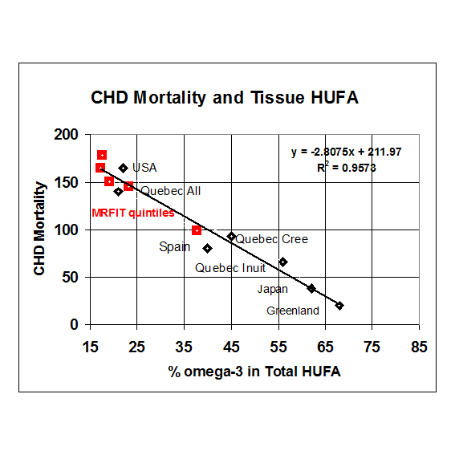
Omega-3 – Cardiovascular Disease
USA consumes the least O3 in developed countries
  60% of Americans are deficient in Omega-3
Lands, Lipids 2003 (Apr.); 38: 317–321

Slide 10
Amazing Benefits of Omega-3 EFA
Heart
Lowers blood pressure
Reduces triglycerides
Slows vascular plaque development
Reduces incidence of arrhythmia, heart attack, sudden death and stroke
Brain
Reduces post-partum and other forms of depression
Improves memory
Reduces vision loss, dementia and Alzheimer’s disease risk
Joint
Reduces joint pain and inflammatory response in autoimmune diseases
https://my.clevelandclinic.org/health/articles/17290-omega-3-fatty-acids

Slide 11
AHA Fish Oil Recommendation
Summary of AHA Recommendations for Omega-3 Fatty Acid Intake
AHA = American Heart Association; CHD = coronary heart disease; EPA = eicosapentaenoic acid; DHA = docosahexaenoic acid. Adapted with permission from Kris-Etherton PM, Harris WS, Appel LJ; American Heart Association. Nutrition Committee. Fish consumption, fish oil, omega-3 fatty acids, and cardiovascular disease. Circulation 2002;106:2755.
Patient population | Recommendation
No documented history of CHD | Eat a variety of fish (preferably oily) at least twice per week. Include oils and foods rich in alpha-linolenic acid (flaxseed, canola, and soybean oils; flaxseeds and walnuts).
Documented history of CHD | Consume approximately 1 g of EPA plus DHA daily, preferably from oily fish. EPA plus DHA capsule supplements may be used in consultation with a physician.
Needs to lower triglyceride level | Consume 2 to 4 g of EPA plus DHA daily in capsules in consultation with a physician.

Slide 12

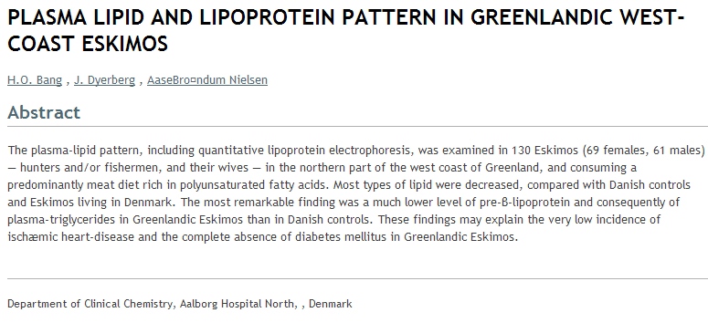
Background: Fish Oil Discovery
Why do Greenland’s Inuit rarely get heart disease in spite of a high-fat diet consisting mostly of whale blubber and seal meat?

Slide 13
Omega-3 EFAs: SCIENCE FACTS
Polyunsaturated fatty acid – concentrated in cold-water fish and seafood in various amounts.
  Note- High heat like cooking lowers O3 levels
Essential Fatty Acid – Human’s cannot make Omega-3’s must be obtained from food
  Note – 2021 research has found that over 68% of adults and 95% of children in the United States do not consume enough omega-3s to meet nutritional needs based on the US Dietary Guidelines
Key ingredients in Fish oil- eicosapentaenoic acid (EPA) and docosahexanoic acid (DHA).
https://www.nutraceuticalsworld.com/contents/view_breaking-news/2021-05-27/study-finds-most-us-adults-have-low-blood-serum-levels-of-omega-3s/#:~:text=A%20study%20published%20in%20the,the%20high%20cardiovascular%20risk%20category.

Slide 14
Omega-3 Effects Every Cell in the Body
  Structural
  In every cell & mitochondria membranes Omega -3 counters overwhelming amounts of arachidonic acid (Omega-6).
  Omega-3 Enhances membrane fluidity, improves protein/enzyme function and ion channel conduction
  Hormonal
  Omega-3 used to make anti-inflammatory hormones –eicosanoids to counter inflammatory prostaglandins from arachidonic acid (Corn oils) Omega-6
Genetic
  Omega-3 binds to transcription factors ( i.e. PPARs and Nrf2) - down regulate gene expression of inflammation
Omega-3 supplementation alters mitochondrial membrane composition and respiration kinetics in human skeletal muscle
J Physiol. 2014 Mar 15; 592(Pt 6): 1341–1352.
Published online 2014 Feb 13. doi: 10.1113/jphysiol.2013.267336
PMCID: PMC3961091 PMID: 24396061

Slide 15
Comparing Omega-3 and Omega-6
(American have TOO MUCH O-6 Due to The Western Diet)
Omega-3- “Good” Prostaglandins | Omega-6- “Bad” Prostaglandins
Prevents blood clots caused by platelet aggregation | Promotes blood clots caused by platelet aggregation
Cause vasodilatation of blood vessels | Cause vasoconstriction of blood vessels
Reduce pain | Promote pain
Decrease cell division | Promote cell division
Enhance the immune system | Depress the immune system
Improve brain function | Depress brain function
A P Simopoulos. Omega-3 fatty acids in health and disease and in growth and development. Am J Clin Nutr September 1991 vol. 54 no. 3 438-463

Slide 16
Latest Research on Omega-3 as a Dietary Supplement
Lung Benefits
  In 2023 a study showed that higher levels of omega-3 fatty acids in a person’s blood were associated with a reduced rate of lung function decline. N = 15,000
Cardiovascular Disease Protection (Recent Studies)
  In the Vitamin D and Omega-3 Trial (VITAL), 840 mg/d of eicosapentaenoic acid (EPA) and docosahexaenoic acid (DHA) resulted in a 28% reduced risk for heart attacks, 50% reduced risk for fatal heart attacks, and 17% reduced risk for total coronary heart disease events.
  In the ASCEND trial (A Study of Cardiovascular Events in Diabetes), cardiovascular disease death was significantly reduced by 19% with 840 mg/d of EPA and DHA.
  In REDUCE-IT (the Reduction of Cardiovascular Events with EPA) there was a 25% decrease in the primary end point of major cardiovascular events with 4 g/d EPA in patients with elevated triglycerides (135–499 mg/dL) who already were taking a statin drug.
Methodist Debakey Cardiovasc J. 2019 Jul-Sep; 15(3): 171–178.
doi: 10.14797/mdcj-15-3-171
PMCID: PMC6822654
PMID: 31687095
Recent Clinical Trials Shed New Light on the Cardiovascular Benefits of Omega-3 Fatty Acids
Investigating associations of omega-3 fatty acids, lung function decline, and airway obstruction. Am J Respir Crit Care Med. 2023; doi: 10.1164/rccm.202301-0074OC

Slide 17
Latest Research on Omega-3 as a Dietary Supplement
Aug 2023 -Preterm babies given a supplement with a combination of omega-3 and omega-6 fatty acids have better visual function by the age of two and a half.
Aug 2023 - omega-3 fatty acid docosahexaenoic acid (DHA) were inversely correlated with hearing difficulty in a new population-based cross-sectional study.
Middle-aged and older adults with higher DHA levels were 8-20% less likely to report age-related hearing issues than those with lower DHA levels.
University of Gothenburg. "Preterm babies given certain fatty acids have better vision." ScienceDaily. ScienceDaily, 24 August 2023. <www.sciencedaily.com/releases/2023/08/230824111854.htm>.
McBurney, a Fellow of the American Society for Nutrition and the Canadian Nutrition Society, will present the findings at NUTRITION 2023, the flagship annual meeting of the American Society for Nutrition held July 22–25 in Boston.

Slide 18
Latest Research on Omega-3 as a Dietary Supplement
May 2023 –Meta-Study
2070 patients with OA and pain of the knee supplementation with n-3 showed 27% improvement in pain.
Conclusions - Supplementation of n-3 PUFAs is effective to relieve pain and improve joint function in patients with OA.
J Orthop Surg Res. 2023; 18: 381.
Published online 2023 May 24. doi: 10.1186/s13018-023-03855-w
PMCID: PMC10210278
PMID: 37226250
Effect of omega-3 polyunsaturated fatty acids supplementation for patients with osteoarthritis: a meta-analysis

Slide 19

Could the Benefits of Omega-3’s Be Improved
With-
Eating More Seafood?
More Traditional EPA/DHA Supplements?
Or Better Omega (Whole Fish) Supplements?
Purification of fish oil to make Supplements removes healthy polyphenols and other types of Omega-3 which likely contribute to the health benefits of oily fish
The Loss of polyphenols and other antioxidants may cause fish oil to break down faster and become rancid
Studies of large populations that consume more seafood are generally healthier that those that don’t, even if they take fish oil supplements
From alga to omega; have we reached peak (fish) oil?, Paul R Clayton corresponding author1 and Szabolcs Ladi 2
J R Soc Med. 2015 Sep; 108(9): 351–357.
doi: 10.1177/0141076815599673 PMCID: PMC4582263 PMID: 26359136

Slide 20

Marine Polyphenols (MP) Provide Essential Benefits
The case for Marine polyphenols (MP) which are a group of bioactive compounds that are found in a wide variety of marine organisms, including algae, fish and crustaceans.
These compounds are characterized by the presence of multiple hydroxyl groups (-OH) in their molecular structures, which give them antioxidant and anti-inflammatory properties
MP also include - flavonoids, phenolic acids, tannins, lignans and stilbenes

Slide 21
REFERENCES:
1. From alga to omega; have we reached peak (fish) oil?Paul R Clayton corresponding author1 and Szabolcs Ladi 2J R Soc Med. 2015 Sep; 108(9): 351–357.doi: 10.1177/0141076815599673PMCID: PMC4582263PMID: 26359136
2. Effect of omega-3 polyunsaturated fatty acids supplementation for patients with osteoarthritis: a meta-analysis J Orthop Surg Res. 2023; 18: 381. Published online 2023 May 24. doi: 10.1186/s13018-023-03855-w PMCID: PMC10210278PMID: 37226250
3. University of Gothenburg. "Preterm babies given certain fatty acids have better vision." ScienceDaily. ScienceDaily, 24 August 2023. <www.sciencedaily.com/releases/2023/08/230824111854.htm>.
4. McBurney, a Fellow of the American Society for Nutrition and the Canadian Nutrition Society, will present the findings at NUTRITION 2023, the flagship annual meeting of the American Society for Nutrition held July 22–25 in Boston.
5. Investigating associations of omega-3 fatty acids, lung function decline, and airway obstruction. Am J Respir Crit Care Med. 2023; doi: 10.1164/rccm.202301-0074OC
6. Recent Clinical Trials Shed New Light on the Cardiovascular Benefits of Omega-3 Fatty Acids Methodist Debakey Cardiovasc J. 2019 Jul-Sep; 15(3): 171–178. doi: 10.14797/mdcj-15-3-171 PMCID: PMC6822654 PMID: 31687095
7. Omega-3 supplementation alters mitochondrial membrane composition and respiration kinetics in human skeletal muscle J Physiol. 2014 Mar 15; 592(Pt 6): 1341–1352. Published online 2014 Feb 13. doi: 10.1113/jphysiol.2013.267336 PMCID: PMC3961091
PMID: 24396061
8. https://www.nutraceuticalsworld.com/contents/view_breaking-news/2021-05-27/study-finds-most-us-adults-have-low-blood-serum-levels-of-omega-3s/#:~:text=A%20study%20published%20in%20the,the%20high%20cardiovascular%20risk%20category.
9. https://my.clevelandclinic.org/health/articles/17290-omega-3-fatty-acids
10. https://www.weforum.org/agenda/2022/11/chart-shows-countries-consume-fish-food-security/
11. https://ourworldindata.org/grapher/per-capita-meat-consumption-by-type-kilograms-per-year?country=OWID_WRL~USA
12. https://www.seafoodsource.com/news/foodservice-retail/americans-consumed-a-record-amount-of-seafood-in-2021
13. https://www.nccih.nih.gov/health/omega3-supplements-in-depth
14. https://www.fda.gov/food/consumers/advice-about-eating-fish
15. https://www.fda.gov/food/environmental-contaminants-food/fdaepa-2004-advice-what-you-need-know-about-mercury-fish-and-shellfish
16. https://ods.od.nih.gov/factsheets/Omega3FattyAcids-HealthProfessional/#:~:text=Cold%2Dwater%20fatty%20fish%2C%20such%20as%20salmon%2C%20mackerel%2C,composition%20of%20the%20food%20that%20the%20fish

