Slide 1
Alzheimer’s Disease Part III
Living Well Radio Show 23
Joseph Maroon, MD, FACS Professor and Vice Chairman Department of Neurosurgery Heindl Scholar in Neuroscience University of Pittsburgh Medical Center Team Neurosurgeon, The Pittsburgh Steelers
Author: The Longevity Factor (Simon&Schuster) Jeff Bost PAC
Clinical Instructor, Neurological Surgery
University of Pittsburgh Medical Center
Clinical Assistant Professor, Chatham University

Slide 2
DISCLAIMER
Every effort has been made by the author(s) to provide accurate, up-to-date information. However, the medical knowledge base is dynamic and errors can occur. By using the information contained herein, the reader willingly assumes all risks in connection with such use. Neither the author nor UPMC, St Barnabas Health System nor any other organization that is affiliated with the authors, shall be held responsible for errors, omissions in information herein nor liable for any special, consequential, or exemplary damages resulting, in whole or in part, from any viewer(s)’ use of or reliance upon, this material.
CLINICAL DISCLAIMER: Clinical information is provided for educational purposes and not as a medical or professional service. Person(s) who are not medical professionals should have clinical information reviewed and interpreted or applied only by the appropriate health professional(s).

Slide 3
Epigenetic Risk Factors and AD
Why Twins don’t die on the sameday?

Slide 4
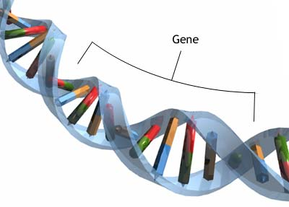
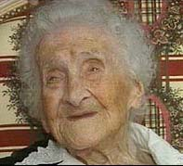
Inherited Genes Only Account for 30% of our Ideal Lifespan

Slide 5
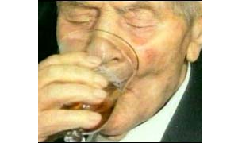
Our Lifestyles and its Action on our Genes Account for 70% of our Ideal Lifespan

Slide 6
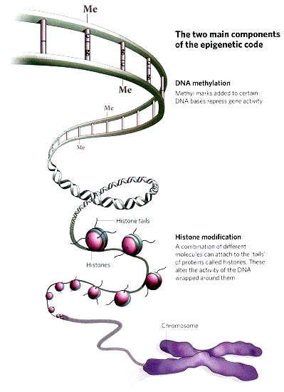
New Science of Epigenetics
Are those factors that if consumed or exposed to can influence our genes to result in either healthy or unhealthy outcomes
Nutrition: Diet quality and amounts; Nutritional Supplements, Vitamins, Mineral and Herbs
Activity: Exercise or Sedentary
Emotional State: Stressed out or Calm
Environment: Polluted or Clean

Slide 7
Unmasking the Genetic Myth of Disease
Epigenetics provides the missing link between the 70% of diseases environmentally* induced and the 30% inherited through our DNA.
*pollution, toxin ingestion, smoking, radiation lifestyle issues - stress, nutrition, weight

Slide 10
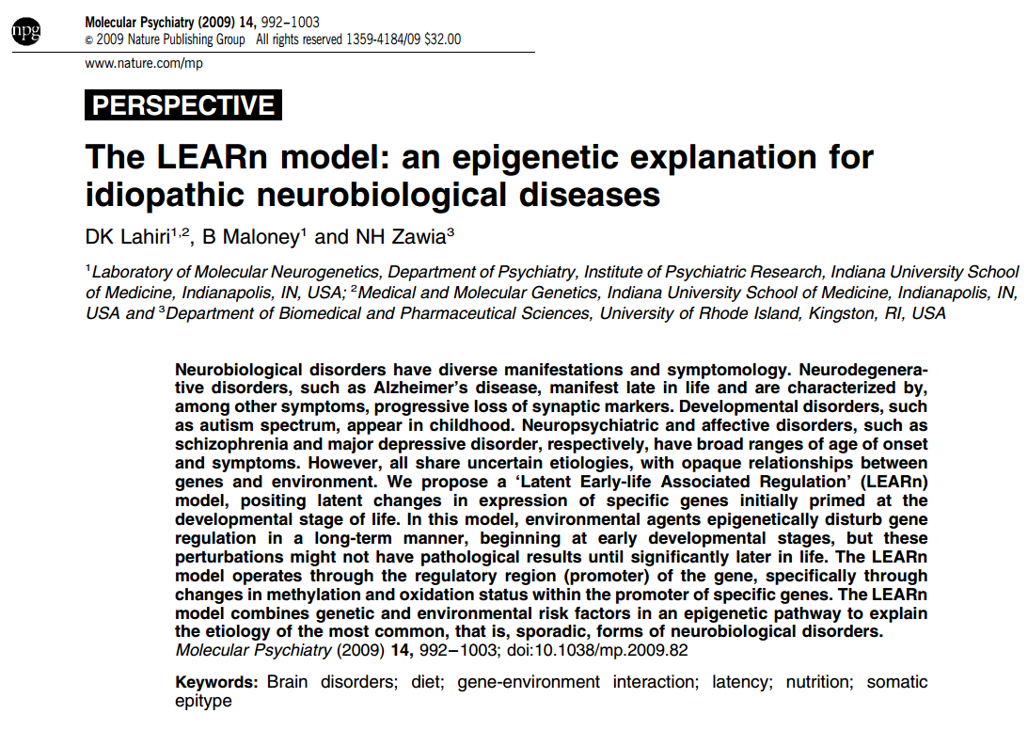
Latent Early-life Associated Regulation (LEARn) model
Later in life epigenetic factors alter genes initially primed at the developmental stage of life but pathological results like AD occur later in life.
Molecular Psychiatry (2009) 14, 992–1003; doi:10.1038/mp.2009.82

Slide 11
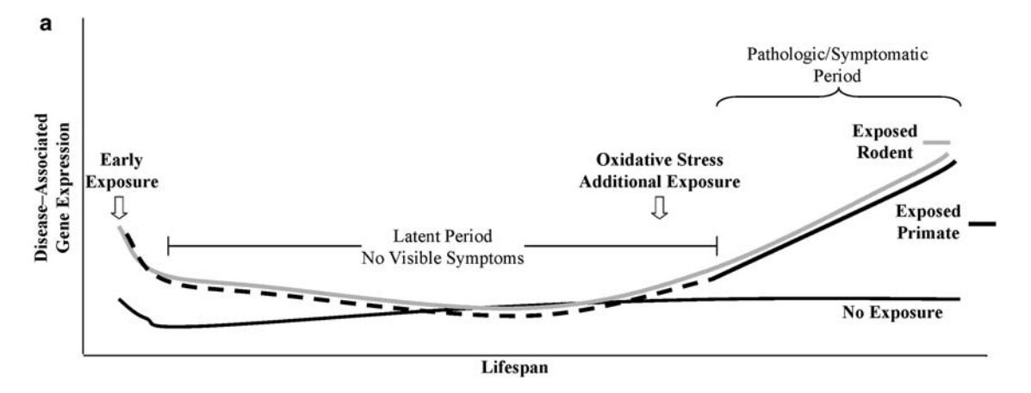
Latent Early-life Associated Regulation (LEARn) model
Early Environmental exposures
Poor prenatal diet and nutrition, low educational level, exposure to heavy metals, pesticides, etc
Environmental exposures
Aging, Obesity, diabetes, brain trauma, chronic hypoxia due to vascular insufficiency, etc
Molecular Psychiatry (2009) 14, 992–1003; doi:10.1038/mp.2009.82

Slide 12
Ways to protect against Alzheimer’s
Epigenetic Activation with:
Exercise
Diet
Limit Environmental Toxins
Stress control
You Have a Choice!

Slide 13
Other Epigenetic Protective Factors for AD
Moderate alcohol
Mediterranean diet
Cognitive activity
Social Connections
Adequate Sleep
NSAIDs/ASA (reduce inflammation)
Estrogen replacement
therapy after menopause?
Ann Neurol. 2006 Jun;59(6):912-21. Mediterranean diet and risk for Alzheimer's disease. Scarmeas N, Stern Y, Tang MX, Mayeux R, Luchsinger JA.

Slide 14
“If there were a drug that could prevent heart attacks, strokes and cancer and treat everything from fragile bones to constipation while quite possibly staving off dementia and improving sleep would anyone over 65 refuse this miracle elixir?”
8 out of 10 seniors forego Exercise
Which has all of these benefits

Slide 15
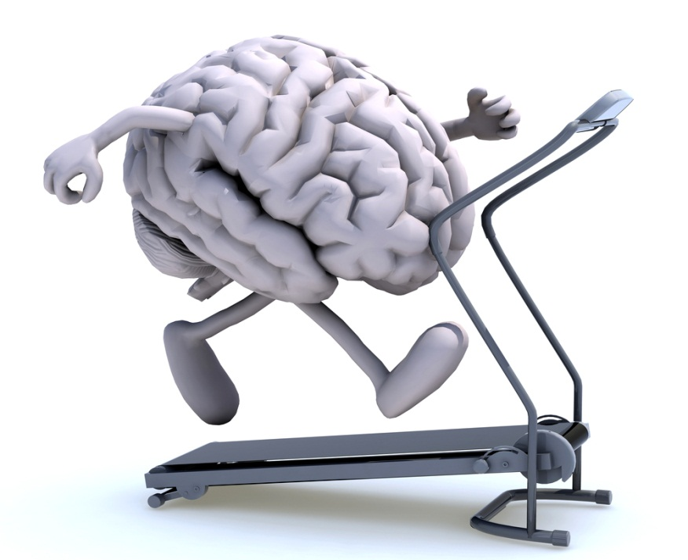
Physical Activity and Brain Thickness
> 72 blocks walking per week increases brain volume
Exercise improves Brain Circulation
Sedentary lifestyle results in gradual brain atrophy

Slide 16
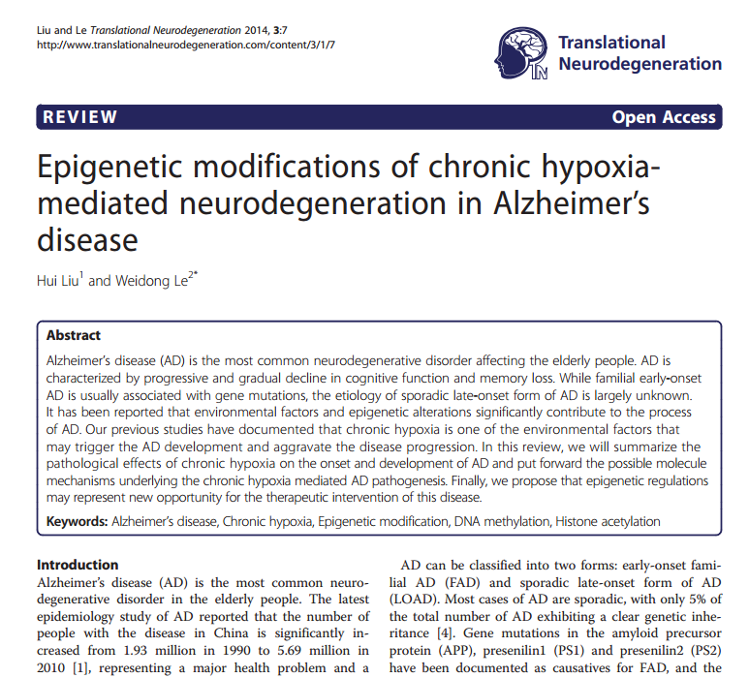
Chronic hypoxia is a common and contributes significantly to the progression of widespread diseases including fever, chronic obstructive pulmonary disease, obstructive sleep apnea syndrome, stroke, cancer, neurodegenerative disorders and etc. It has been shown that individuals who have suffered severe hypoxia or ischemia are more susceptible to developing AD

Slide 17
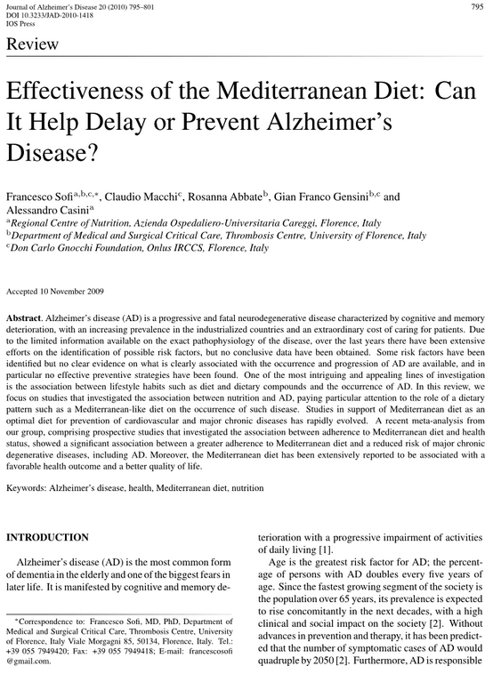
Dietary Prevention
META-analysis, comprising prospective studies that investigated the association between adherence to Mediterranean diet and health status, showed a significant association between a greater adherence to Mediterranean diet reduces risk of major chronic degenerative diseases, including AD.

Slide 18
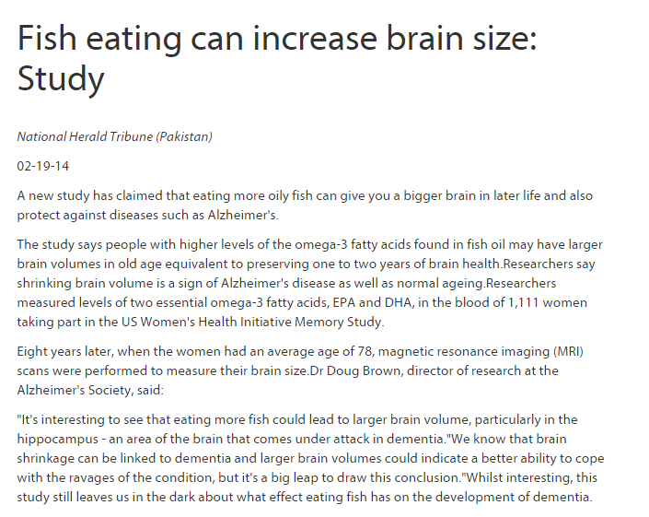
Fish Consumption
Dietary
Prevention
Twice weekly baked or broiled fish helps preserve brain volume and protect against AD
Cyrus A. Raji, Kirk I. Erickson, Oscar L. Lopez, Lewis H. Kuller, H. Michael Gach, Paul M. Thompson, Mario Riverol, James T. Becker. Regular Fish Consumption and Age-Related Brain Gray Matter Loss. American Journal of Preventive Medicine, 2014; DOI: 10.1016/j.amepre.2014.05.037

Slide 19
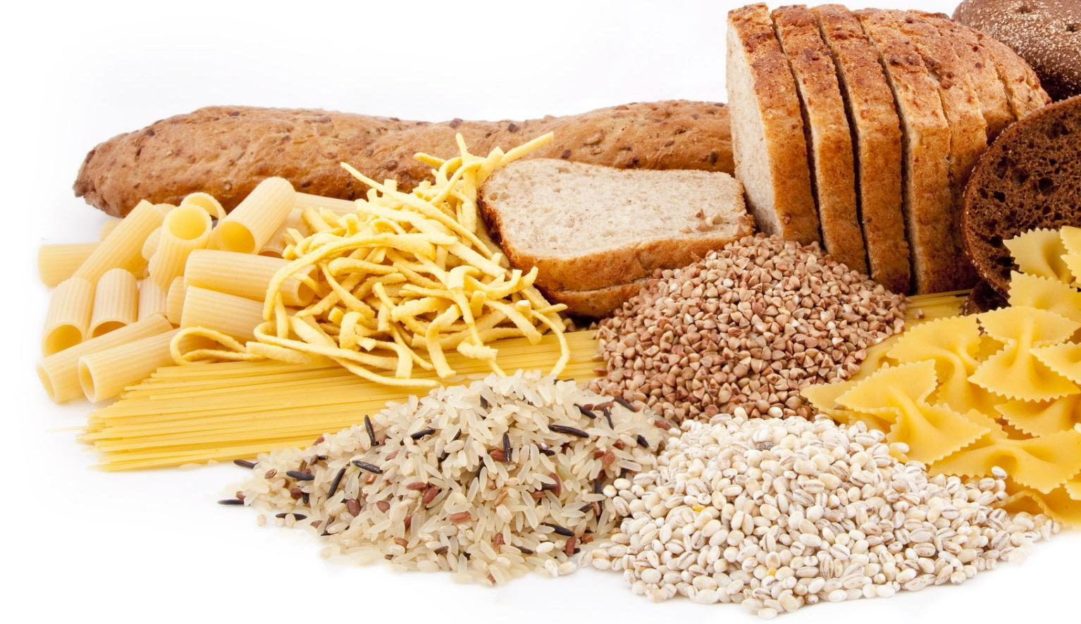
Inflammatory Markers Increase AD Risk
Dietary
Prevention
Excessive Carbohydrates in Diet,
History of Pre-Diabetes and Diabetes Increase
Advanced Glycosylated End-products- AGEs
AGEs greater in poorly controlled DM, females and obesity
Sugar binds to nerves leads to neuropathy
Eventually increases brain amyloid and AD Risk

Slide 20
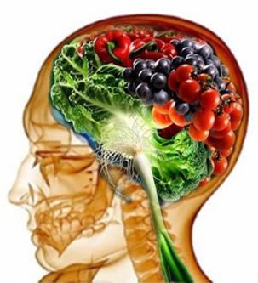
Brain Health Diet
20% “good” fats*
extra virgin olive oil
Avocado
flax seed oil
40% lean proteins*
Fish
Chicken
Turkey
soy (vegetable)
40% complex carbohydrates*
fresh fruits & vegetables
whole grains (lower glycemic index)
Legumes
Superfoods
Blueberries
Spinach
Fish oil
Red Grapes
Nuts and Seeds
Modest amt. Caffeine
Dark Chocolate
*http://www.alzheimersprevention.org/4-pillars-of-prevention/diet-and-supplements

Slide 21
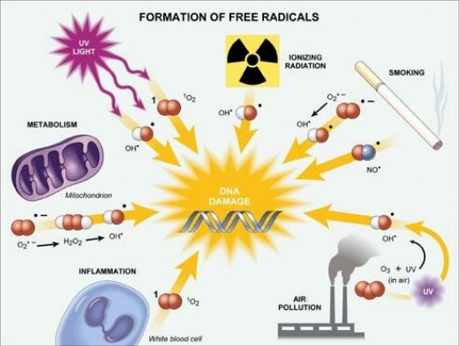
Environmental Exposures
Excessive Free Radials and AD

Slide 22
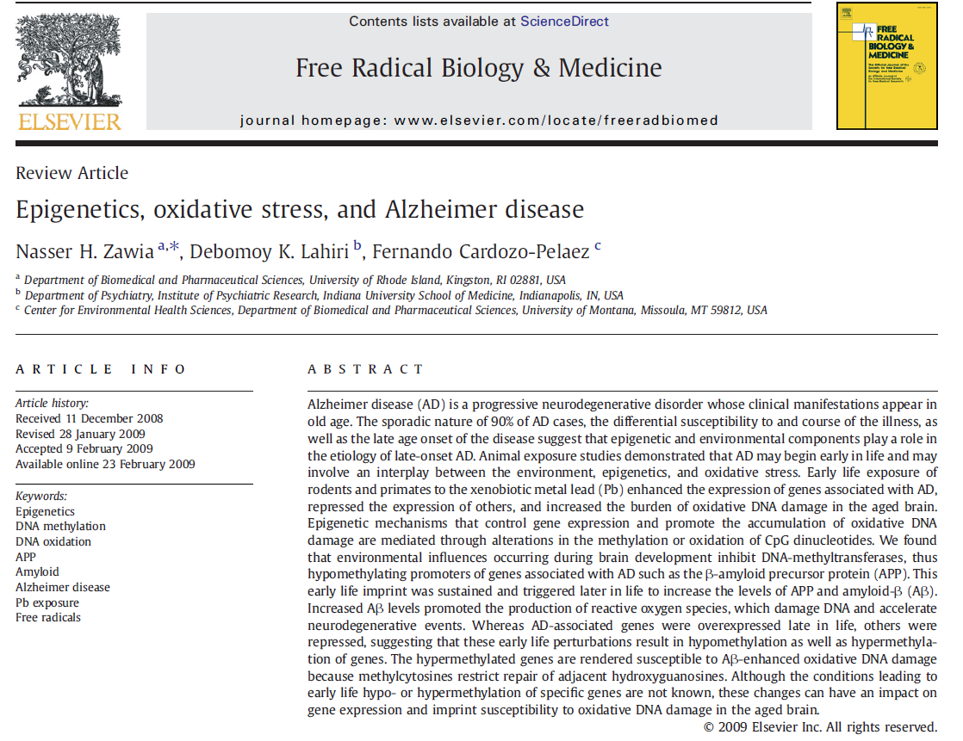
Environmental Exposures
Heavy Metal Toxins – Lead
“Animal studies from strongly suggest that exposure to lead during development can be a risk factor that promotes the pathogenesis of AD”
N.H. Zawia et al. / Free Radical Biology & Medicine 46 (2009) 1241–1249

Slide 23
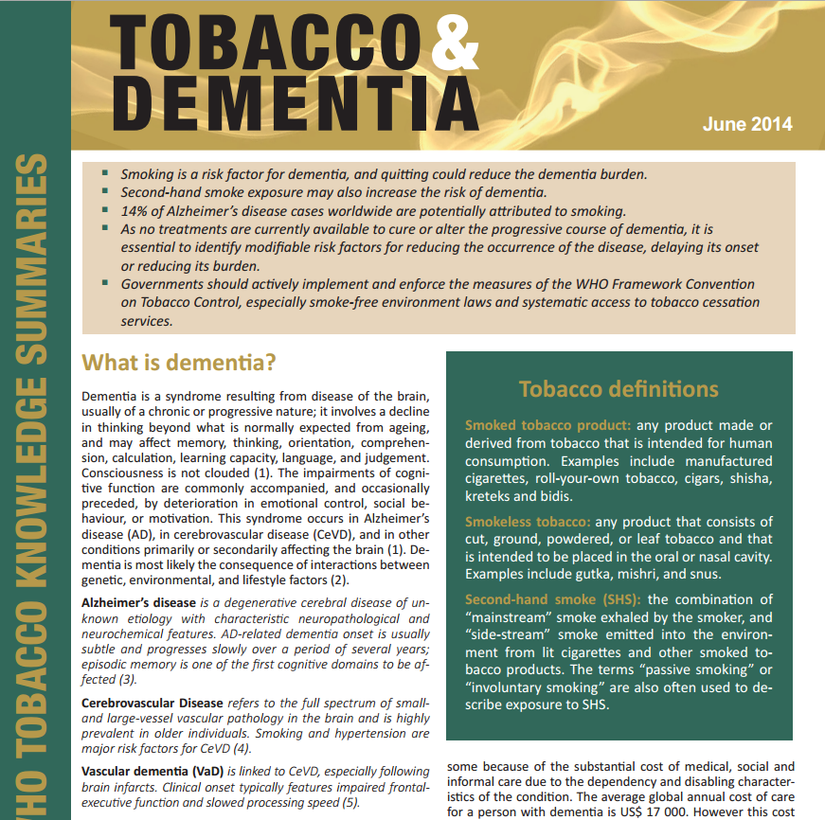
The report found that smokers have a 45 % higher risk of developing dementia than non-smokers, and concluded that 14 % of all Alzheimer's cases worldwide may potentially be attributed to smoking.
June 2014

Slide 24
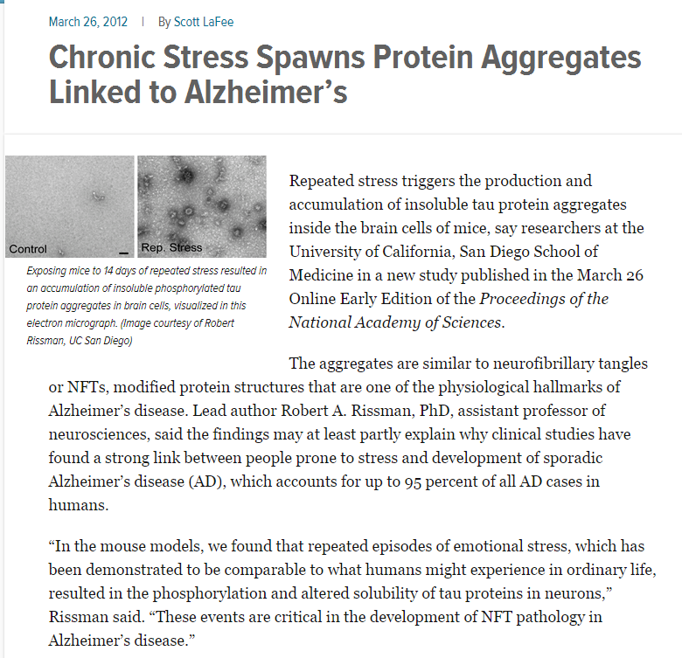
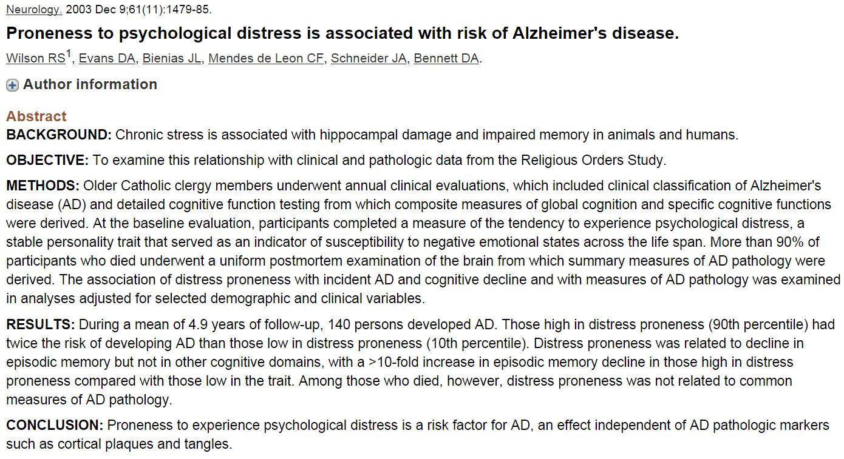
Stress in AD Found in Humans and Shown to Happen in Mice, Stress increases AD risk
During a mean of 4.9 years of follow-up, 140 persons developed AD. Those high in distress proneness (Stress) had twice the risk of developing AD than those low in (Stress)
Those with High levels of Stress had memory function 10X worse than Less Stress
http://ucsdnews.ucsd.edu/pressrelease/chronic_stress_spawns_protein_aggregates_linked_to_alzheimers/

Slide 25
TBI (Traumatic Brain Injury) and AD
Facts:
Research has linked moderate and severe TBI to a greater risk of developing AD and other types of dementia years after the original head injury.
Older adults with a history of moderate TBI had a 2.3 times greater risk of developing AD than seniors with no history of head injury
A history of severe TBI had a 4.5 times greater risk.
There’s no evidence that a single mild TBI increases dementia risk
http://www.alz.org/dementia/downloads/topicsheet_tbi.pdf

Slide 26
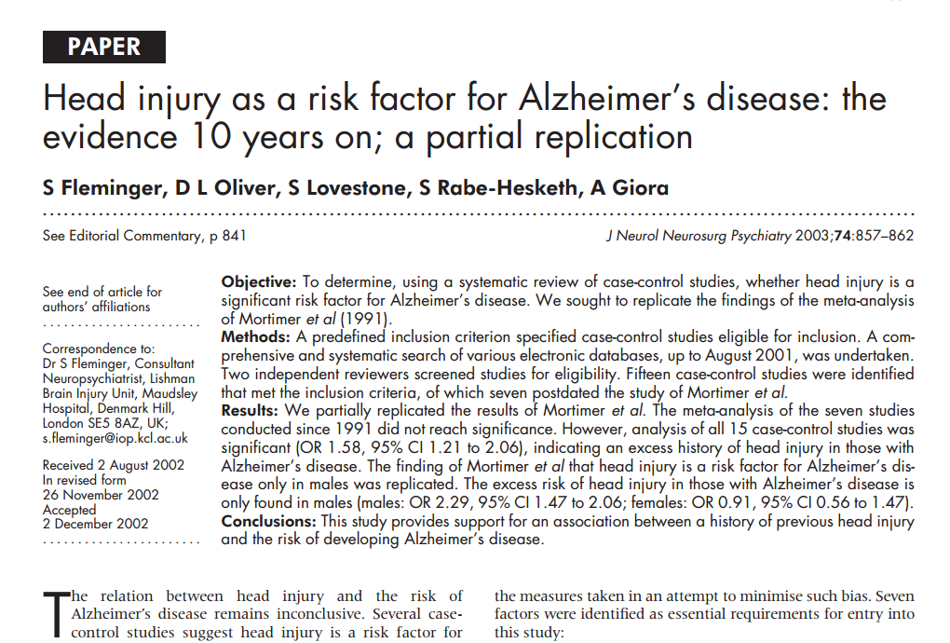
TBI (Traumatic Brain Injury) and AD
This (META) study provides support for an association between a history of previous head injury with LOC
and the risk of developing Alzheimer’s disease in males and less in females suggesting estrogen protection
J Neurol Neurosurg Psychiatry 2003;74:857–862

Slide 27
Traumatic Brain Injury (TBI), Cognitive Change and Dementia
TBI is a significant threat to cognitive health:
TBI’s direct effects — which may be long-lasting or even permanent — can include unconsciousness, confusion, difficulty learning and remembering new information, unsteadiness, etc
TBI increased the risk of developing Alzheimer’s and other forms of dementia years after the injury takes place
Major Causes of TBI in Elderly
Falls are the leading cause of TBI for all ages.
Those > 75 yrs have the highest risk
Motor vehicle accidents
http://www.alz.org/dementia/downloads/topicsheet_tbi.pdf

Slide 28
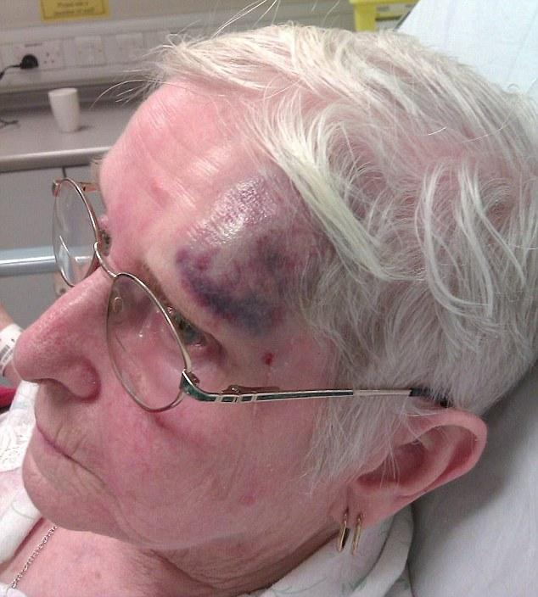
Traumatic Brain Injury (TBI) to AD How?
TBI releases of inflammatory and free radical molecules inducing hallmark protein abnormalities as seen in AD within hours after severe TBI
TBI causes localized and global brain ischemia
TBI has been shown to increase levels of beta-amyloid, one hallmark Alzheimer’s protein.

Slide 29
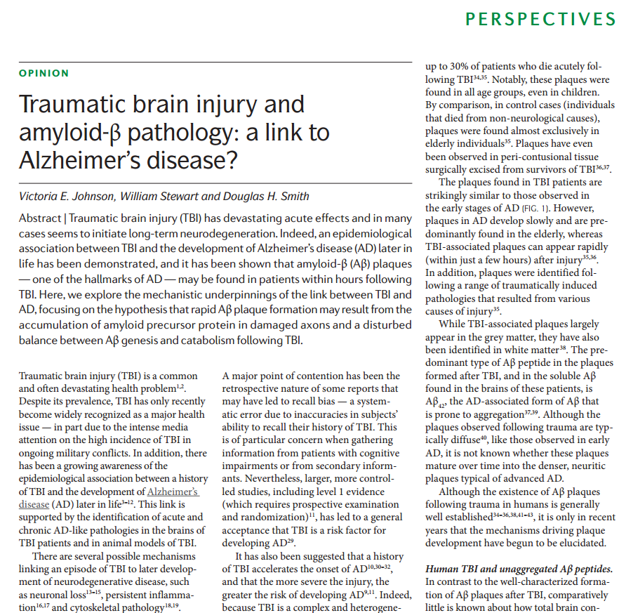
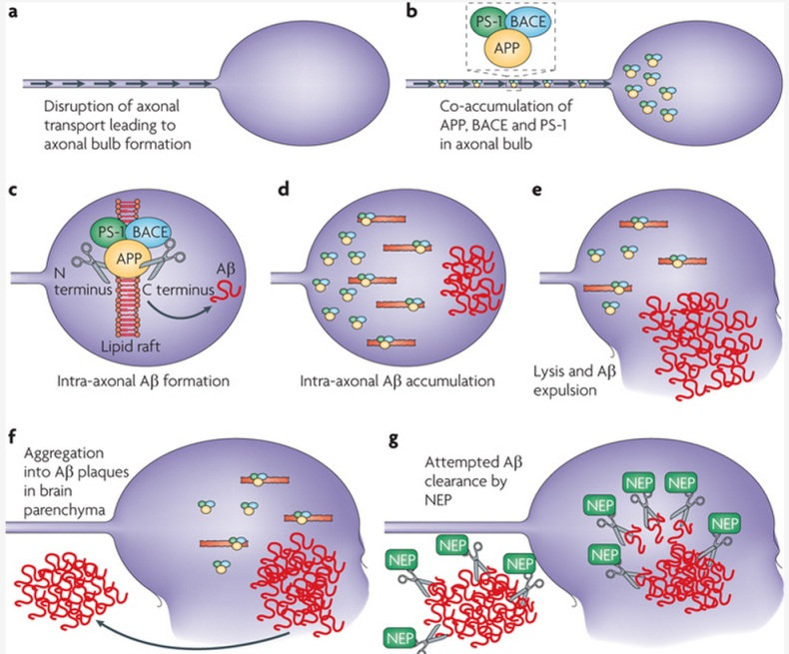
Traumatic Brain Injury (TBI) to AD How?
NATurE rEvIEWS | NeuroscieNce voLumE 11 | mAy 2010 | 361
The link between trauma and AD is extremely complex, but found to be related to pathological accumulation of multiple proteins within axons damaged by trauma. This parallels axonal involvement in AD

Slide 30
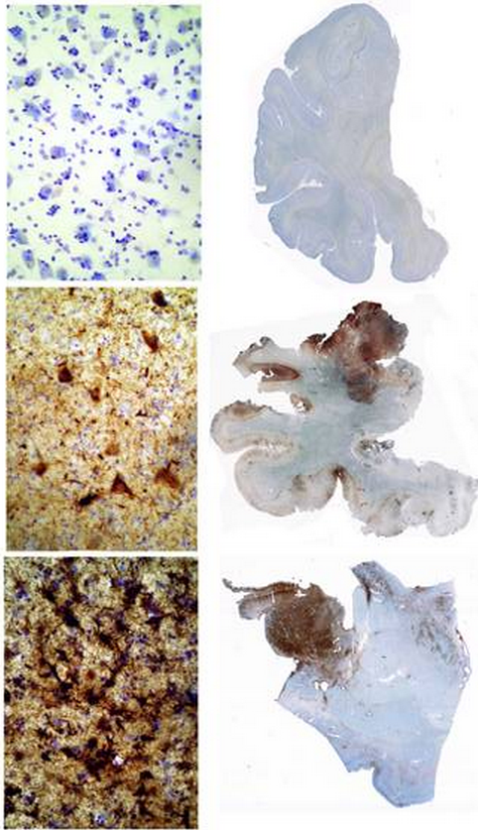
Chronic Traumatic Encephalopathy is NOT AD
What is CTE?
Neurodegenerative changes in the brain linked to brain trauma found on autopsy
Found in very focal areas of the brain in 153 athletes*
The unique pathological changes allow for differentiation from AD
Not necessarily related to any symptoms of dementia prior to death
*Chronic Traumatic Encephalopathy in Contact Sports: Is There an Epidemic?
Joseph C. Maroon, MD, FACS, Robert Winkelman, BS, Jeff Bost PAC, Austin Amos, BS, Chris Mathyssek, PhD, Vincent Miele, MD
Presented Oct 2014 CNS Annual Meeting Boston MA

Slide 31
Role of Dietary Supplements for AD
Strong Science Based
Folic acid- reduces homocysteine (inflammatory) levels
vitamin B12
vitamin D (2,000 to 5,000 IU) check blood levels
Vitamin C (~2,000 mg/day)
magnesium,
DHA/EPA fish oil - 1 to 3 gms/day
High potency multiple vitamin and mineral capsule.
Good Science Based
coenzyme Q10
alpha lipoic acid
ginkgo biloba
phosphatidylserine
acetyl-L-carnitine
huperzine-A
vinpocetine
Oken BS, Storzbach DM, Kaye JA. The efficacy of Ginkgo biloba on cognitive function in Alzheimer disease. Arch Neurol 1998;55:1409-15
Crook TH, Tinklenberg J, Yesavage J, Petrie W, Nunzi MG, Massari DC. Effects of phosphatidylserine in age-associated memory impairment.Neurology 1991;41:644-9.
Maroon JC, Bost J, Fish Oil: The Natural Anti-Inflammatory, Basic Health Publications, 2006 National Institute on Aging; Georgetown University Medical Center. A multi-center, double-blind, placebo-controlled, therapeutic trial to determine whether natural Huperzine A improves cognitive function. ClinicalTrials.gov. Washington (D.C.): 2008 Feb [cited 2010 Jan 4]. Szatmari SZ, Whitehouse PJ. Vinpocetine for cognitive impairment and dementia. Cochrane Database Syst Rev. 2003;1:CD003119.

Slide 32
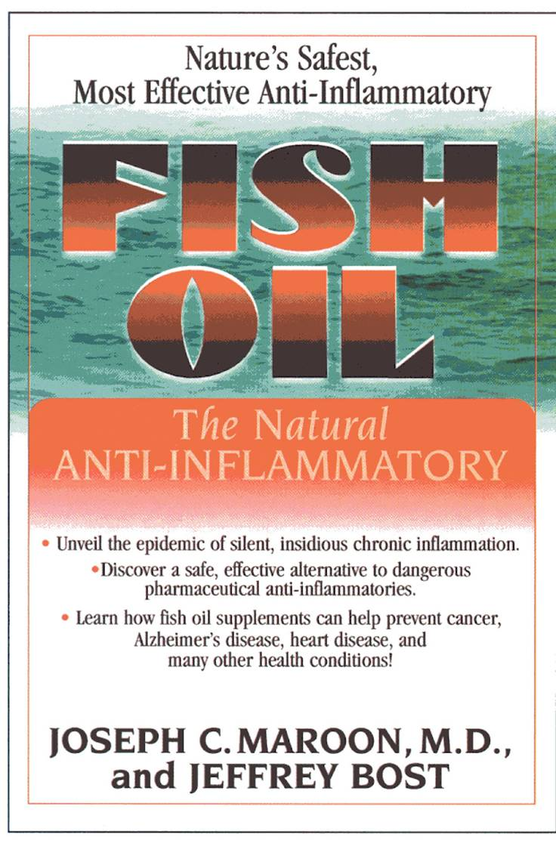
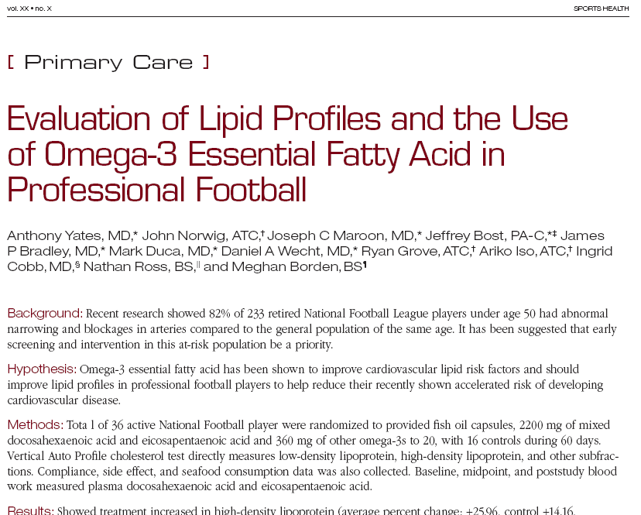
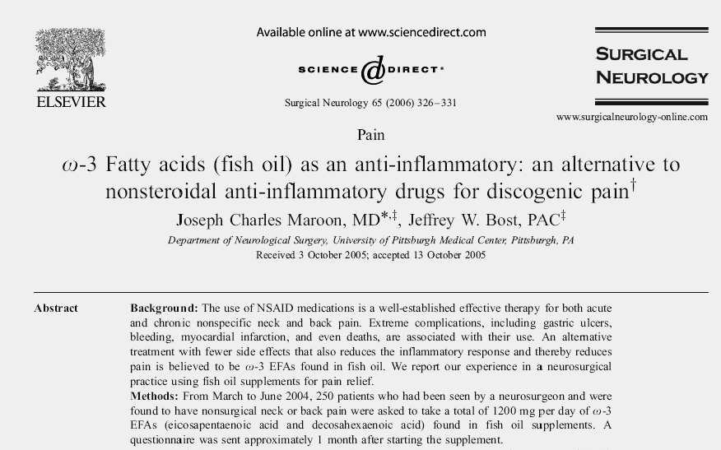
Sports Health Vol 1, Jan 2009
Significantly improved the lipid profile of active players randomized to treatment. O3 hould be considered as a method to improve modifiable cardiovascular risk lipid factors in professional football players.
Reduced Discogenic pain in most, 66% able to stop NSAIDS.

Slide 33
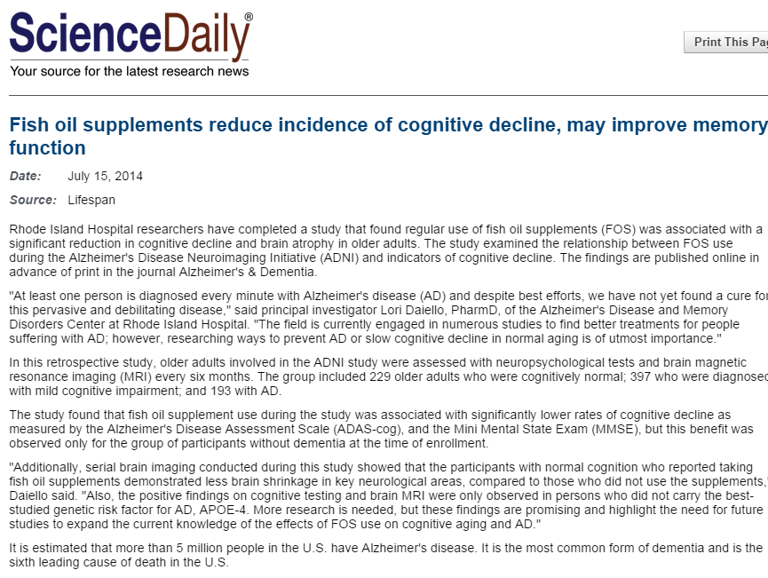
Lori A. Daiello, Assawin Gongvatana, Shira Dunsiger, Ronald A. Cohen, Brian R. Ott. Association of fish oil supplement use with preservation of brain volume and cognitive function. Alzheimer's & Dementia, 2014; DOI:10.1016/j.jalz.2014.02.005
NO HEAVY METALS IN FISH OIL SUPPLEMENTS COMPARED TO ALL FISH CONTAMINATED DUE TO POLLUTION!
Regular use of fish oil supplements (FOS) was associated with a significant reduction in cognitive decline and brain atrophy in older adults

Slide 34
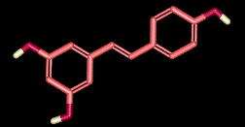
NEW Research on AD and Supplements Resveratrol
Resveratrol is a small molecule in a class called Polyphenols (found in red grapes, green teas, dark chocolate, and peanuts)
Often concentrated in red wine grape skins (and therefore red wines) and manufactured by a variety of plants when they are stress
They are used by plants to protect them (phytoalexins) from microbe attacks and high UV radiation, among other protective functions
Notes:
34
34

Slide 35
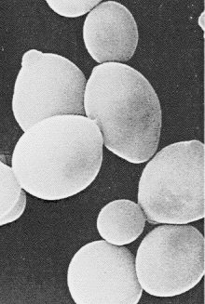
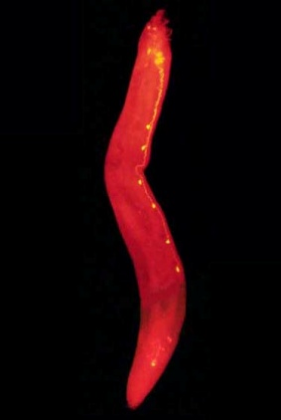
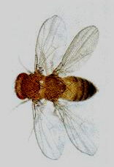
Resveratrol has been found to activate longevity genes in all animals tested so far to improve health, reduce disease and lengthen lifespan
Yeast
Roundworms
Flies
Mice
Monkeys

Slide 36
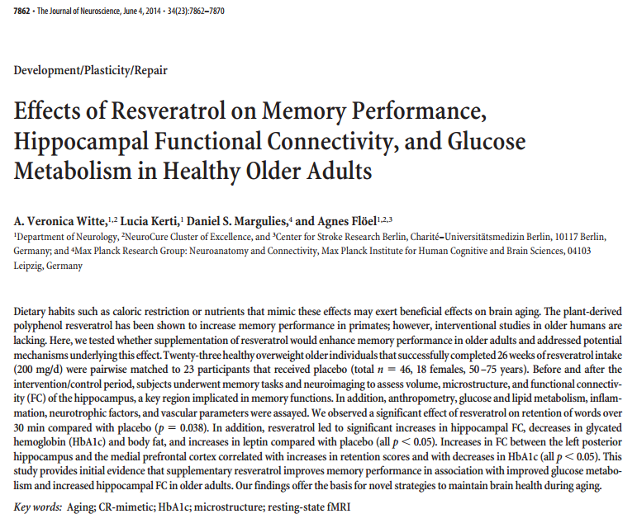
Witte AV, Kerti L, Margulies DS, Floel A. “Effects of resveratrol on memory performance, hippocampal functional connectivity, and glucose metabolism in healthy older adults.” J Neurosci. 2014 Jun 4;34(23):7862-70.

Slide 37
Effects of Resveratrol on Memory Performance, Hippocampal Functional Connectivity, and Glucose Metabolism in Healthy Older Adults
Design: 23 healthy overweight older subjects, 26 weeks of resveratrol (200 mg/d) ,23 placebo (total n 46, 18 females, 50–75 years)
Interventions:
memory tasks, neuroimaging to assess volume, microstructure, and functional connectivity (FC) of the hippocampus,
BMI, glucose and lipid metabolism, inflammation, neurotrophic factors, and vascular parameters
Results:
significant effect of resveratrol on Memory retention of words (p 0.038).
significant increases in hippocampal FC
decreases in HbA1c and body fat
increased in leptin (all p 0.05)
Increased connections between the left posterior hippocampus and the medial prefrontal cortex correlated with increases in retention scores and with decreases in HbA1c (all p0.05).
Conclusion: Supplementary resveratrol improves memory performance in association with improved glucose metabolism and increased hippocampal FC in older adults

Slide 38
Health Benefits of Resveratrol
Ischemia
Protective
Ant-i-Viral
Anti-Inflammatory
Antioxidant
Cardio-Protective
Cancer
Protective
Neuro-Protective
Anti-Aging
Improved
insulin
sensitivity
Antibacterial
Diabetes
Prevention
Reduces
obesity

Slide 39
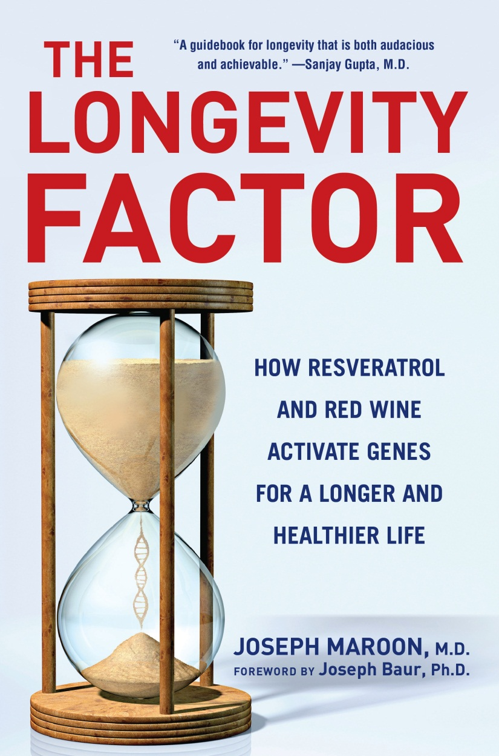
RESVERATROL BENEFITS
Minimizes risks of heart disease
Enhances endurance
Preserves memory and enhances learning
Improves locomotor skills

Slide 40
Other Questions
What do you see as the future of dementia and Alzheimers diagnosis?
Do you feel we will be able to eventually alter this disease to where it can be completely reversed?
If both parents had Alzheimers and died from it, is it likely that their adult child will have Alzheimers too? Is it possible to skip that child?
Is there a test that can be done now to determine if that child will develop Alzheimers?
Is there something holding us back from finding out more about the disease? Regulations, etc.

