Slide 1
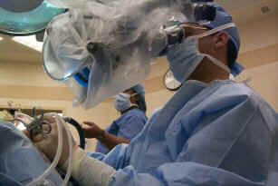
Alzheimer’s Disease Part I
Living Well Radio Show 21
Joseph Maroon, MD, FACS Professor and Vice Chairman Department of Neurosurgery Heindl Scholar in Neuroscience University of Pittsburgh Medical Center Team Neurosurgeon, The Pittsburgh Steelers
Author: The Longevity Factor (Simon&Schuster) Jeff Bost PAC
Clinical Instructor, Neurological Surgery
University of Pittsburgh Medical Center
Clinical Assistant Professor, Chatham University

Slide 2
DISCLAIMER
Every effort has been made by the author(s) to provide accurate, up-to-date information. However, the medical knowledge base is dynamic and errors can occur. By using the information contained herein, the reader willingly assumes all risks in connection with such use. Neither the author nor UPMC, St Barnabas Health System nor any other organization that is affiliated with the authors, shall be held responsible for errors, omissions in information herein nor liable for any special, consequential, or exemplary damages resulting, in whole or in part, from any viewer(s)’ use of or reliance upon, this material.
CLINICAL DISCLAIMER: Clinical information is provided for educational purposes and not as a medical or professional service. Person(s) who are not medical professionals should have clinical information reviewed and interpreted or applied only by the appropriate health professional(s).

Slide 3
AD History – Pathology Disease of the Brain discovered at Death
On November 3, 1906, a clinical psychiatrist and neuroanatomist, Alois Alzheimer, reported “A peculiar severe disease process of the cerebral cortex” to a Meeting of South-West German Psychiatrists
He described a 50-year-old woman with paranoia, progressive sleep and memory disturbance, aggression, and confusion, until her death 5 years later.
At Autopsy he reported distinctive plaques and neurofibrillary tangles as seen through a microscope.

Slide 4
Symptoms of AD Cognitive Decline
Alzheimer’s (AHLZ-high-merz) is a disease of the brain that causes problems with memory, thinking and behavior.
AD is not a normal part of aging

Slide 5
Incidence/Cost of Alzheimer’s Disease
More than 5 million Americans have Alzheimer’s disease, the most common form of dementia.
7th leading cause of death
Alzheimer’s accounts for 60 to 80 % of all dementia cases.
11 % - age 65 and older
30 % - 85 and older
AD impacts more than 15 million family members, friends and caregivers.
Medicare and Medicaid Treatment Cost covers $175 billion/yr.
$250 billion is spent annually in out-of-pocket healthcare for Alzheimer’s,

Slide 6
Other types of Dementia
Second most Common -Vascular dementia is a decline in thinking skills caused by conditions that block or reduce blood flow to the brain, i.e., strokes and atherosclerosis of brain blood vessels.
Mixed dementia – Simple due to various causes.
Parkinson’s disease dementia – affecting certain parts of the brain- Basal ganglia and Neurotransmitters
Dementia with Lewy bodies is a type of progressive dementia
Huntington’s disease dementia is a progressive brain disorder caused by a defective gene
Frontotemporal dementia (FTD) -progressive cell degeneration in the brain’s frontal lobes or temporal lobes
Korsakoff syndrome is a disorder caused by severe deficiency of thiamine (vitamin B-1). (Alcohol Abuse)

Slide 7
HOW ALZHEIMER’S AFFECTS THE BRAIN
The changes that take place in the brain begin (at the microscopic level) long before (10 years) the first signs of memory loss.
This is a MAJOR CAUSE of Delayed Treatment and Poor Outcome

Slide 8
Signs and symptoms of Alzheimer's disease
Memory problems – Most often first sign of cognitive impairment
This referred to as - mild cognitive impairment (MCI).
With MCI - more memory problems than normal for their age, but symptoms do not interfere with their everyday lives.
Movement difficulties and problems with the sense of smell have also been linked to MCI.
MCI is a major risk for developing Alzheimer’s, but not all do
(Discuss Later another show – has to reduce the risk of dementia and slow Progression)
The first symptoms of Alzheimer’s vary from person to person.
These include -nonmemory problems
Word-finding
Vision/spatial issues,
Impaired reasoning or judgment

Slide 9
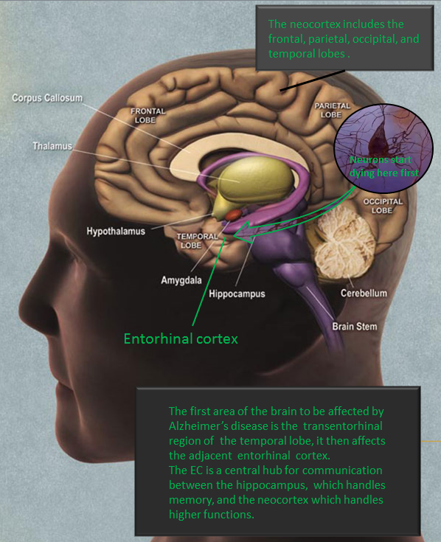
Latest Research on AD
Loss of smell may be first symptom and sign due to Entorhinal plaque location
Usman A Khan, Li Liu, Frank A Provenzano, Diego E Berman, Caterina P Profaci, Richard Sloan, Richard Mayeux, Karen E Duff, Scott A Small. Molecular drivers and cortical spread of lateral entorhinal cortex dysfunction in preclinical Alzheimer's disease. Nature Neuroscience, 2013; DOI: 10.1038/nn.3606

Slide 10
Stages of Alzheimer's disease
Mild Alzheimer’s disease
As Alzheimer’s worsens, people experience greater memory loss and other cognitive difficulties. Wandering and getting lost, trouble handling money and paying bills, repeating questions, taking longer to complete normal daily tasks, decline in hygiene and personality and behavior changes. People are often diagnosed in this stage.
Moderate Alzheimer’s disease
In this stage, damage occurs in areas of the brain that control language, reasoning, conscious thought, and sensory processing, such as the ability to correctly detect sounds and smells. Memory loss and confusion grow worse, and people begin to have problems recognizing family and friends. They may be unable to learn new things, carry out multistep tasks such as getting dressed, or cope with new situations. In addition, people at this stage may have hallucinations, delusions, and paranoia and may behave impulsively.
Severe (End-stage) Alzheimer’s disease
Ultimately, plaques and tangles spread throughout the brain, and brain tissue shrinks significantly. People with severe Alzheimer’s cannot communicate and are completely dependent on others for their care. Near the end of life, the person may be in bed most or all of the time as the body shuts down.

Slide 11
Diagnosing AD
Typically a Neurologist or Psychiatrist
Ask the person and a family member or friend questions about overall health, use of prescription and over-the-counter medicines, diet, past medical problems, ability to carry out daily activities, and changes in behavior and personality.
Conduct tests of memory, problem solving, attention, counting, and language.
Carry out standard medical tests, such as blood and urine tests, to identify other possible causes of the problem.
Perform brain scans, such as computed tomography (CT), magnetic resonance imaging (MRI), or positron emission tomography (PET), to support an Alzheimer’s diagnosis or to rule out other possible causes for symptoms.

Slide 12
Diagnosing AD
AD is diagnosed clinically after other dementia-related conditions are eliminated as the cause
Tests like CT Scan, MRI, and SPECT (Blood Flow Scan) are used to exclude other causes
Post-mortem evaluation is the only definitive method

Slide 13
Role of PET SCANS?
Recently, PET scans (positron emission tomography), a form of brain imaging, has been used to detect Alzheimer's-related "plaques"
These same PET scans have found plaques in non-demented subjects
In these cases the location of the plaques were not associated with symptoms. (Not at the TIPPING POINT)
Brain pathological changes (build up) that can eventually leads to clinical symptoms of AD can begin years before the onset of symptoms
PET Scan must always have associated clinical symptoms of AD before the clinical diagnosis is made.
Most times AD diagnosis is made based on symptoms and the exclusion of other reversable causes of dementia.

Slide 14
Microscopic Pathology of AD
There are 3 consistent neuropathological hallmarks:
Amyloid-rich senile plaques -Pathologic amyloids forms when previously healthy proteins lose their normal structure and physiological functions (misfolding) and form fibrous deposits in amyloid plaques around cells which can disrupt the healthy function of tissues and organs.
Neurofibrillary tangles - In healthy neurons, tau normally binds to and stabilizes microtubules (neuron feeding tubes). In Alzheimer's disease, however, abnormal chemical changes cause tau to detach from microtubules and stick to other tau molecules, forming threads that eventually join to form tangles inside neurons.
Finally, Neuronal degeneration occurs, brain cells die and the functions that they control deteriorate.

Slide 15
Traditional Risk Factors for AD
Advance Age
Female
H/O Cardiovascular disease
Elevated BP
H/O MCI*
H/O Traumatic brain injury
Certain
Possible
*Mild Cognitive Impairment - subtle memory changes that do not significantly affect daily life. People affected with MCI are at high risk to convert into AD

Slide 16
Genetic Risk Factors for AD
Mutations of chromosomes 1, 14, 21
Rare early-onset (before age 60) familial forms of dementia
Down syndrome
Apolipoprotein E4 on chromosome 19
APOE*4 allele - ↑ risk & ↓ onset age in dose related fashion
APOE*2 allele may have protective effect

Slide 17
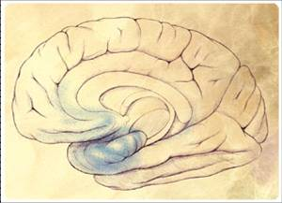
Types of AD
Early-onset familial AD (FAD)
Sporadic late-onset form of AD (LOAD).
Most cases of AD are sporadic, with only 5% of the total number of AD exhibiting a clear genetic inheritance

Slide 18
What goes wrong in the brain?
The brain has 100 billion nerve cells (neurons). Each nerve cell connects to many others to form communication networks.
In addition to nerve cells, the brain includes cells specialized to support and nourish other cells.
The brain weighs about 3 lbs, but receives about 25% of the bodies blood supply.
Reason – HIGH METABOLIC RATE
Brain cells operate like tiny factories.
With the blood providing oxygen and nutrition, brain cells generate energy to construct and breakdown neurotransmitters, build proteins and use it to get rid of waste.

Slide 19
Theories on What Breaks down in Alzheimers Disease
Amyloid Hypothesis – the toxic waste product amyloid builds up and results in plaque's made of tangled proteins that eventually kill and disrupt brain cells.
Lysosomal Storage problem Hypothesis- if the material that enters the lysosome cannot be degraded, those pieces cannot leave the lysosome. The cell then decides the lysosome is not working and ‘stores’ it.
Infection Hypothesis – Prior infection sets up antigen – antibody reaction that targets brain cells.
Aging Hypothesis – Natural process of cellular failure with aging (Mostly disproven) but does contribute to other theories
Inflammation – Diet, Environmental and Lifestyle Hypothesis – These factors play the greatest role in epidemiological studies as to which populations are at greatest risk of AD.

Slide 20
Next Week - Preview
Further discuss the causes of AD
Explore the reversable risk factors
Reveal all the ways you can start lowering your risk of dementia and AD – AT ANY AGE

Slide 21
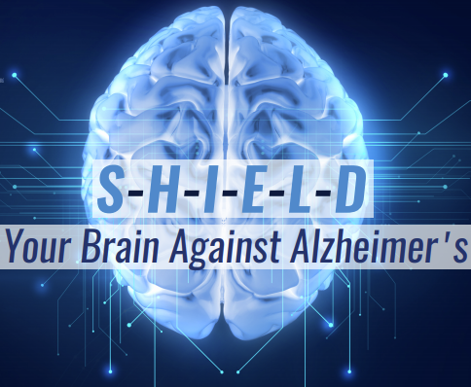
Sneak Peek of Next Week’s Show
SHIELD
Sleep
Handling Stress
Interact with others
Learn new things
Exercise– BDNF
Diet—Mediterranean plant based
Recommended by Dr. Rudolph Tanzi, professor of neurology at Harvard Medical School and the director of the Alzheimer’s Genome Project™
https://www.aging.senate.gov/imo/media/doc/SCA_Tanzi_09_25_19.pdf

